Slide 1
Season 9 Schools Pack

Slide 2
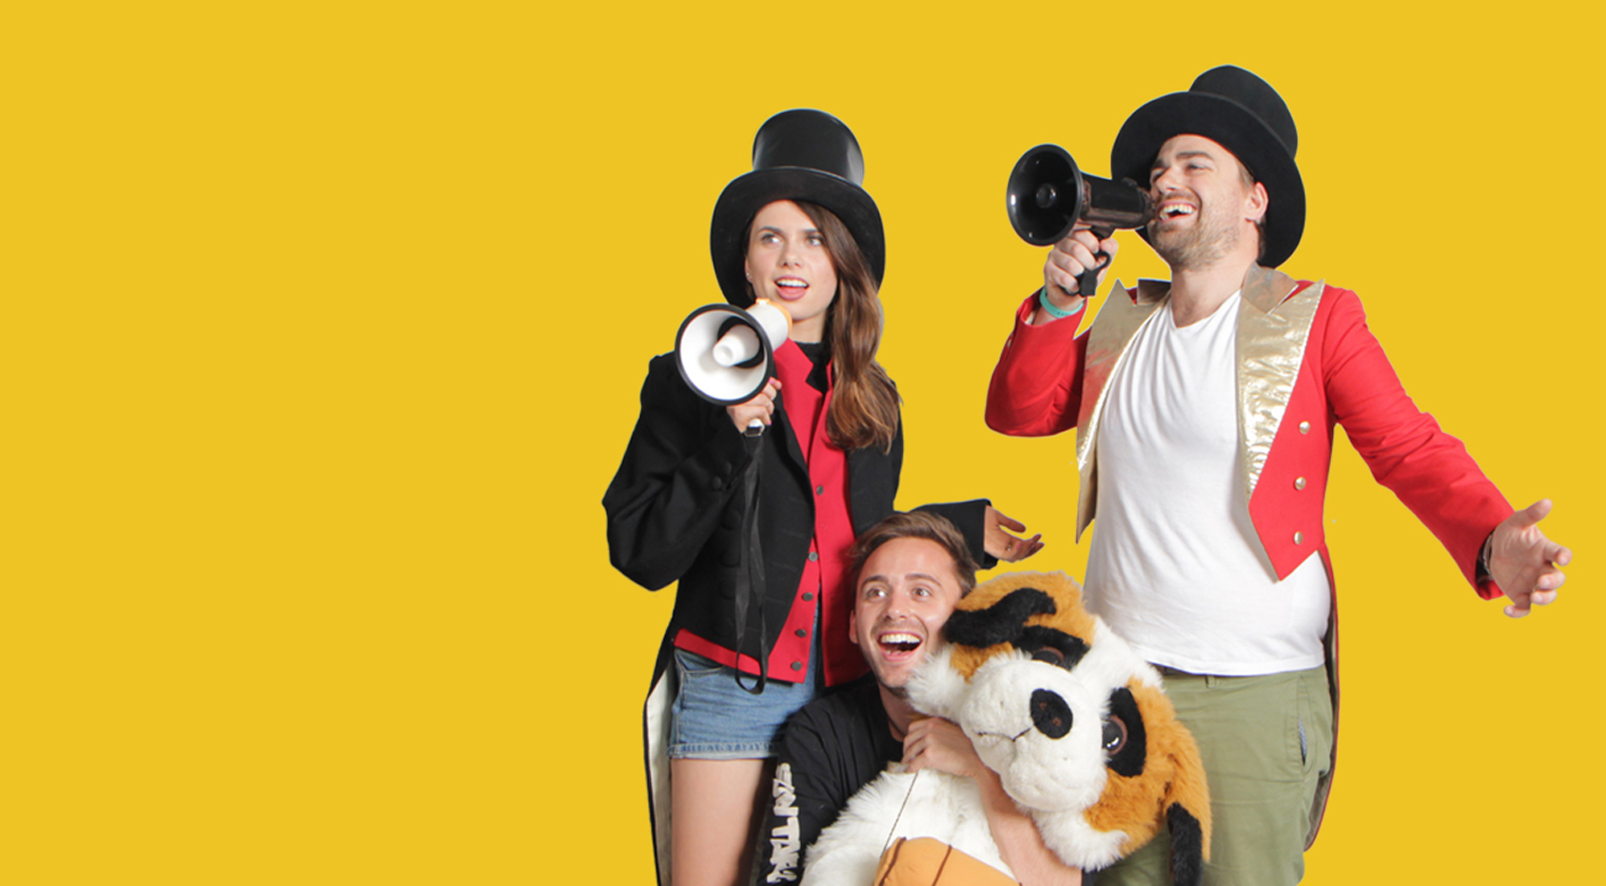
Is it ever okay to be a cannibal? | 1
Are parents hypocrites? | 5
When should you stop being friends with someone? | 7
Should we put GPS trackers on kids? | 11
Should grown-ups lie to you? | 17
Short & Curly is a fast-paced, fun-filled ethics podcast for kids and their parents or teachers, with questions and ideas to really get you thinking. It asks curly questions about animals, technology, school, pop culture and the future.
The activities in this pack are designed to be used alongside listening to the podcast, in the classroom, but can easily be adapted for use at home.
Each episode begins with a listening guide, followed by a group activity around the central theme or question.

Slide 4
Episode 1: Is it ever okay to be a cannibal?
Part 1: warm-up
Listen: (Link to ep)
Pause at thinking question 1: how does the idea of eating another human make you feel, and why do you think you have this reaction?
Think, pair, share (1-2 minutes)
3. Continue episode, thinking about two questions: What should Molly and Carl do? What would you do, if your choices were to starve to death or eat a human?
4. Pause the podcast before the ‘brains trust’ section at 11m 20s so students can discuss their answers to the question.
5. Pause at thinking question 2: is it ever okay to eat another human?
6. Think, pair, share (1-2 minutes)
Ask your students the central question: Is cannibalism ever okay? Give students a minute or two to think about their responses to this question and jot them down.
Next, tell students to flip their arguments to formulate reasons in opposition to their true views: If a student thinks cannibalism is never okay, they must come up with some reasons to support the argument that cannibalism is okay in some situations, and vice versa. Explain clearly that these views needn’t be reflective of their personal opinions. The idea is to practice coming up with persuasive arguments for and against in order to really think about an issue.
Depending on how much time you have, give groups time to write their arguments out and develop their ideas, following the A-R-E model for developing arguments:
A: Assertion. An assertion is a statement of opinion or point of view.
R: Reasoning. This is the ‘because’ part of an argument.
E: Evidence. This is the ‘for example’ part, that supports the reasoning.
Model this process to the class, using an example such as:
A - Rainy days are better than sunny days
R – Because school is more fun when it’s raining
E – For example, last time it rained we watched a movie in the classroom at lunchtime.

Slide 5
Episode 1: Is it ever okay to be a cannibal?
Part 2: Tug-of-war
Post it-notes: students will need 2-3 each
This activity builds on the game of tug-of-war to help students understand the complex forces that ‘tug’ at either side of an ethical dilemma. It encourages students to reason carefully about the ‘pull’ of various factors that are relevant to any dilemma, and underscores the deeper complexity of issues of morals, fairness and right from wrong.
The use of a rope and the ‘what-if’ questions make students’ thinking visible, and demonstrates the interconnectedness of ideas The post-it notes and the action of the rope, real or illustrated, represent the collaborative thinking of the group as a whole. This is a key point about making thinking visible: It shows the dynamic interaction of people's thoughts in a context of a shared inquiry. Documenting thinking and making it visible in the classroom can facilitate this interaction in order to make the inquiry richer.
This works best as a whole class activity.
Present the dilemma to the class. Draw or display a rope with the two ends representing the opposing sides of the dilemma and ask students to think about what side of the dilemma they would be on and why.
Students write their top 2-3 reasons (from warm-up activity) on post-it notes. Encourage students to think of other reasons or ‘tugs’ or both sides of the dilemma.
Next, have students add their post-it notes to the rope, discussing as the rope is ‘pulled’ in either direction.
Once all students have contributed, ask them to generate some ‘what-if’ questions. E.g., ‘What if someone had given their permission to be eaten?’ In doing this, they will come up with questions, issues, factors or concerns that might need to be explored further to resolve the issue.
Write and post these above the rope.
Finish the lesson by asking students to reflect on the activity. What new ideas they have about the dilemma? Do they still feel the same way about it? Have they made up minds or changed their minds?

Slide 6
Episode 1: Is it ever okay to be a cannibal?
Extension
You may wish to take this activity further, with the following whole-class activities.
Four Corners
To begin with, label each corner of the classroom with four statements: Strongly agree, agree, disagree, strongly disagree.
First, ask students to write a paragraph stating their position on the statement ‘Cannibalism is never okay’, choosing one of the four degrees of agreement.
Once this is done, they will move to the corner of the classroom where they see their position posted on the wall. The strongly disagree position is posted in the right-hand corner, while the agree position is posted in the left-handed corner, and so on.
Once students move to their corner, they get a few minutes to discuss their thoughts. Appoint one person the note-taker and one person the speaker.
Next, invite each speaker to state their first point on the topic, moving around the group in turn. On the second time around, students must rebut the previous arguments they have heard.
Students may move corners depending on whose argument they find more convincing.
At the end of four rounds, the corner with the most support wins the argument. Here, it is important to note that this victory doesn’t necessarily mean the winning argument is ‘right’ or ‘true’. Rather, it simply means more people were convinced of this point of view. To extend this idea, ask students to discuss how this style of ‘winning’ could be problematic.
Ball-Toss Debate
Students choose a side the cannibalism question, or any topic with opposing points of view.
Each student goes to the side of the classroom where their position is either for or against the topic. Move desks so that each side is facing each other. Have students sit on their desks and take turns tossing a ball to discuss their position on the topic. Only the student with the ball can speak.
This exercise does a good job of teasing out students’ perspectives on the role of reasons in support of their views and helps them develop a better sense of how we employ reasons to defend our beliefs, as well as giving them some opportunity to practice doing so.
4

Slide 8
Episode 1: Is it ever okay to be a cannibal?
Activity: Comic relief
Listen: (Link to ep)
Pause at thinking question 1: What are some examples of when your parents have had one rule for you, but a different rule for themselves?
Think, pair, share (1-2 minutes).
Continue episode, thinking about 2 questions: Are double standards always bad, or are there exceptions? Are your parents hypocrites?
Pause the podcast before the ‘brains trust’ section at 11m 20s so students can discuss their answers to the question.
Finish podcast, then discuss possible reasons why their parents may have used a double standard in each case.
In pairs, students will create two comic book strips, using the templates provided (appendix 2): one which illustrates an example of a double standard that is not okay, and one which shows an example of a double standard that is acceptable.
This activity is particularly well-suited to reluctant writers, enabling them to easily sequence their ideas and articulate their stories with pictures first, and then words. This makes it much easier to see how the story will work at beginning, middle and end. The short amount of text required in comics – short sentences and one-word exclamations - will be less daunting than sitting down in front of a blank page which needs filling.
First, ask students to come up with an idea for a scene they can draw which illustrates each one of these.
Next, ask them to think about who the characters are and what dialogue they’ll use. This should be written out before students begin their comics.
Give students blank comic templates to begin their comics. You may like to explore some different graphics, fonts and so on that are used in comics
You can access free chapters of the Alex Rider graphic novels here:
https://alexrider.com/
6

Slide 10
Episode 1: Is it ever okay to be a cannibal?
Activity: Wanted
In this activity, students will create a ‘Wanted’ ad for a new friend.
Begin with a general discussion about ‘Wanted’ ads, explaining that they are a type of classified ad used to attract people to jobs and other positions.
Display a series of ‘wanted’ ads, in any format, to examine as a group (some examples are included, but you can use any sort of wanted ads you’d like to).
Explain to students that, as with a job ad, they will be writing an ad for a set of skills / qualities that they would like in a new friend. Their instructions, to display on the board:
Listen: (Link to ep)
Pause at thinking question 1: Is it ever okay to stop being someone’s friends?
Think, pair, share (1-2 minutes).
Listen to the podcast up until the next thinking question: if your friends saw you do something mean or selfish, what do you think you should do about it?
After listening to the podcast, students discuss their thoughts on these questions, and friendship in general.
Pretend that you are trying to make a new friend. Write an ad that describes a friend you would like to find.
Start with the basics – what age range are you looking for? Does it matter it they are a girl or a boy?
What personality traits are you looking for in a friend? What kind of person do you think would make a great friend?
Are there any activities that you would like to share with this new friend? If you spend a lot of time rollerblading, you might want a friend to share this activity with you.
Are there some things that you don’t want in a friend? Include these as well.
Once ads are finished, display them somewhere so they may be reviewed by peers.
8

Slide 11
Activity 2: Friendships focus group
To set up this game, place three markers of any sort in three different corners; one red, one orange and one green (this may be as simple as a piece of paper that reads ‘red light’ and so on).
The object of this game is to decide which in a range of scenarios are most compatible with each of the following three statements:
these are bad signs in a friendship (red)
these are warning signs in a friendship (orange)
these are good signs in a friendship (green)
Students will be asked to allocate each scenario to a corner. You can do this in any way you like, including:
You might read the scenarios aloud and ask students to move to where they think they best belong themselves
You can give scenarios out to groups of students and they can arrive at a consensus.
You can place the scenarios on the board and ask students to write them down on post-its, then stick them in whichever corner the belong to.
No matter what strategy you use to play this game, be sure that you ask students for explanations regarding their choices. The most important part of this activity is the discussion around whether each scenario constitutes a good, a warning or a bad sign in a friendship.
When there is disagreement, you might choose not to place the scenario beside one statement, but rather choose to set it aside for further debate and discussion. However, f the scenario clearly represents a bad or warning sign, be sure to make this clear for your students.
9

Slide 12
Episode 1: Is it ever okay to be a cannibal?
There are fifteen scenario cards. Five scenarios correspond with each coloured stoplight: red (unhealthy/bad signs), yellow (warning signs) and green (healthy/good signs). While there may be some discrepancies, the following is a list of suggested correct answers.
Red Light
You are afraid of your friend’s temper.
Your friend criticises you or people you care about.
Your friend threatens to hurt you.
Your friend bullies and makes fun of you or other kids at school.
Your friend pressures you to do things you do not want to do.
Orange Light
You are nervous that if you tell your friend something personal, s/he will tell other people at school.
Your friend sometimes makes fun of you.
You rarely get to plan what the two of you will do together.
Your friend tells you not to hang out with certain people.
You say that you agree with your friend, even when you really don’t. You are afraid they won’t be your friend anymore if you disagree.
Green Light
You usually feel happy when you are with this person.
Your friend respects your feelings and your opinions.
Your friend talks to you about his/her feelings.
Your friend is happy when good things happen to you.
You enjoy being with this person, but you also enjoy spending time with other friends.
10

Slide 14
Episode 1: Is it ever okay to be a cannibal?
Activity: Look, see or watch?
Warm-up:
Define the three words: look, see and watch. Ask students what the difference is between each of these, and what each one implies. Describe a situation in which you do each of these things: look, see, and watch. Which one has the most sinister connotation, and why?
Briefly introduce the concept of the panopticon prison (literally ‘all seeing’ prison), pioneered by Jeremy Bentham. Explain that the panopticon was designed as a system of control.
Explain that while Jeremy Bentham never built his prison, and eventually rejected the idea, there have been several panopticon prisons built in the past.
Display image of Cuban panopticon prison (next slide).
Ask:
Look at this photo of an old Cuban prison. It was built in a panopticon style. What makes this prison different to traditional ones? How do you think the design of this building works to control inmates?
Listen: (link to ep)
1. Pause at thinking question 1: How do you know when someone is mature enough to go out without supervision?
2. Think, pair, share (1-2 minutes)
3. Pause the podcast before the ‘brains trust’ section at 12m 20s so students can discuss their answers to the question: should your parents be using GPS devices to track you?
12

Slide 16
Explain that the aim of the design is to allow all inmates of an institution to be observed / watched without the inmates being able to tell whether or not they are being watched.
Next, divide students in to groups and give them 5-10 minutes to discuss how being watched would change their own behaviours. They will need to think about how they’d feel if their parents / teacher / siblings could be watching them at any time. Ask: pretend you live in a panopticon house – you don’t know when you are being watched, but you may be observed at any time. How does this change your behaviour?
Explain that although it is physically impossible for a single ‘watchman’ in such a prison to observe all the inmates’ cells at once, the fact that the inmates cannot know when they are being watched means that they are motivated to act as though they are being watched at all times. Thus, they are effectively compelled to regulate their own behaviour.
Consolidation: draw a panopticon home, in which parents may observe their children at all times, or vice versa.
Activity 2: IDEALists
In this activity, students will revisit the central question: Should parents track their kids using GPS?
Explain that in this activity, students will be examining a decision-making process called IDEAL. This follows a series of steps and is a system which may be applied to any decision.
First, describe each of the IDEAL steps:
I – Identify the problem.
D – Describe how you might solve this problem.
E – Evaluate all the possible solutions.
A – Act on one of the solutions.
L – Learn from your choices.
Split students into groups of any number to undertake their decision-making activity.
14

Slide 17
Dear Class,
My name is Milly, and I’m 11 years old. I’m allowed to walk to and from school each day, as both my parents work full time. My best friend Molly lives just around the corner from me and we usually walk home together. Mum and I have an agreement that I phone her as soon as I get home each afternoon, but I sometimes forget. Usually it’s because I’m talking to Molly and just lose track of time, or I forget to do it when I get home. I have to admit, once or twice I have done the wrong thing and gone to the shop or the park without telling mum or dad, and they’ve been really worried. So now they’ve said that I have to wear a GPS tracker at all times so they can track me. They assure me they won’t use it unless they absolutely have to, but I think this is a gross invasion of my privacy! They should trust me.
Our family is in deadlock over this issue.
What should we do?
Yours Sincerely,
Milly.
Next, read out a letter to the class which poses the question they will be making a decision on.
Students will now work through each of the decision-making steps in their books to solve Milly’s problem (display next slide for this activity)
Consolidation: Student share their decisions, discussing each point they have worked through.
To finish, have students write a letter to Milly, stating their final recommendations and reasons for them.
15

Slide 18
Dear Class,
My name is Milly, and I’m 11 years old. I’m allowed to walk to and from school each day, as both my parents work full time. My best friend Molly lives just around the corner from me and we usually walk home together. Mum and I have an agreement that I phone her as soon as I get home each afternoon, but I sometimes forget. Usually it’s because I’m talking to Molly and just lose track of time, or I forget to do it when I get home. I have to admit, once or twice I have done the wrong thing and gone to the shop or the park without telling mum or dad, and they’ve been really worried. So now they’ve said that I have to wear a GPS tracker at all times so they can track me. They assure me they won’t use it unless they absolutely have to, but I think this is a gross invasion of my privacy! They should trust me.
Our family is in deadlock over this issue.
What should we do?
Yours Sincerely,
Milly.
I – Identify the problem faced by your character/s.
D – Describe a number of ways s/he might solve this problem:
E - Evaluate all the possible solutions. Ask yourself: “What would happen if the character chose this solution versus another one?” Choose the solution that you think is best. Be prepared to defend your choice.
Note that ‘A’ and ‘L’ steps are followed once the decision has been made:
A – Act on advice (Milly does as they suggest)
L – Learnings. What might Milly learn from this process?
15

Slide 19
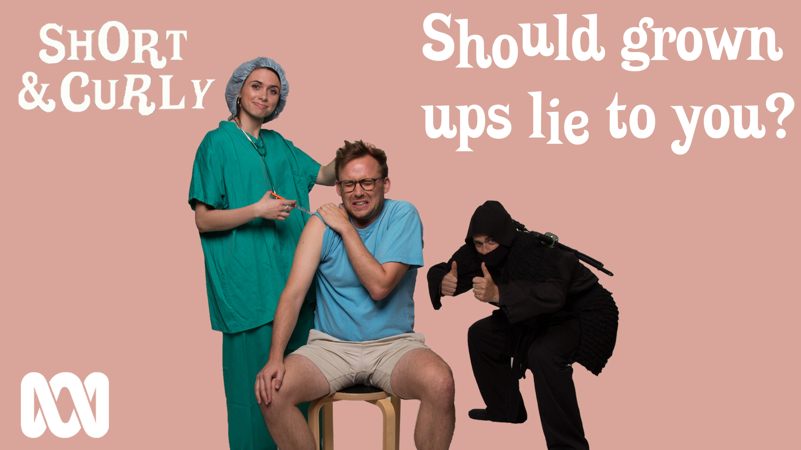

Slide 20
Episode 1: Is it ever okay to be a cannibal?
Activity 1: Fibs, lies or porky pies?
Ask: Are there different types of lies? What are they?
In this activity, students will understand that some lies are more damaging in effect than others, and that there are different types of lies.
Explain that you are going to read out some different types of lies, and the students are going to rate them in terms of harmfulness by standing at certain points along a straight line.
Draw or imagine a line across the room, with one end representing the number 1 – the least harmful – and the other end representing 10 – the most harmful.
Ask for volunteers / call on students to respond to each of the lies you read out, making sure several students respond at once – or even the whole class – to elicit conversation about why they have chosen these spots. The most discussion will occur when students stand in different spots along the line.
White Lie: Saying you have plans when you don’t, to get out of something
Broken promises: Saying you will do something when you know you won’t., or not delivering on something you committed to
Fabrication: Spreading rumours or false claims. Lying about another person.
Bold-faced lie: this is a lie that everyone knows to be a lie.
Lying in exaggeration: Enhancing eh truth by adding lies to it.
Lies of deception: lying by not telling all the facts, or creating a false impression
Plagiarism: Stealing someone else’s intellectual property
Telling lies when the truth would be better, not being able to stop telling lies to get attention. Compulsive lying: Telling lies when the truth would be better, not being able to stop telling lies to get attention.
Listen: (Link to ep)
Pause at thinking question 1: Have you ever told a lie to make someone feel better?
2. Think, pair, share (1-2 minutes)
3. Listen to the podcast up until the next thinking question: Imagine your friend thinks something is true but you know it isn’t. Do you have to tell them, and do you have an example?
4. Think, pair, share (1-2 minutes)
17

Slide 21
Activity 2: Would I lie to you? (cont)
Begin by writing a number of facts about yourself across the board. Of these, one should be untrue. Some ideas are:
I have a cat and her name is…
I can speak German
I once saved someone’s life
My toes are abnormally short
Explain that one of the answers is untrue. Tell the groups to formulate more questions to find out which answer is untrue (e.g. what type of cat is it? How do you say good afternoon in German?)
Give students five minutes to do this.
Next, encourage each group to ask you their questions, answering truthfully except when asked about the fact that is a lie. Here, try to use some inconsistencies when answering questions about your untrue statements, as clues to your untruth.
When students have run out of things to ask you, give them a couple of minutes to discuss in their groups which fact they think is a lie.
Then, after asking each group for their opinion, spill the beans and tell them which fact is untrue. If your statements were too easy, you can redo the activity or change the statements, making sure each time that you make a point of using the body cues when discussing the lie.
18

Slide 22
Activity 2: Would I lie to you?
Next, ask each student to write down one true thing about themselves, and one untrue. Try to make both statements interesting or unusual – to make them harder to guess (e.g. true: I once met Zac Efron, untrue: I have swum with dolphins).
In groups of three, students will take turns to sit before the class and be ‘interrogated’ in the same way you have modelled. The rest of the class take turns to ask each of them specific questions relating to their statements in order to decide if they are true or not.
Encourage the ‘liars’ to invent a backstory for their lies, so they aren’t easily caught out be questions like: when did this happen? Where were you? How old were you? And so on.
Encourage the rest of the class to look for inconsistencies which may give away their lies.
Consolidation – Discuss:
How did you go in guessing the untrue statements?
How could you tell when someone was lying?
What gave it away?
Finish this activity by briefly discussing why some lies are far more serious than others, with examples of each of the categories outlined earlier.
19

