Slide 1
Season 10 Schools Pack

Slide 2
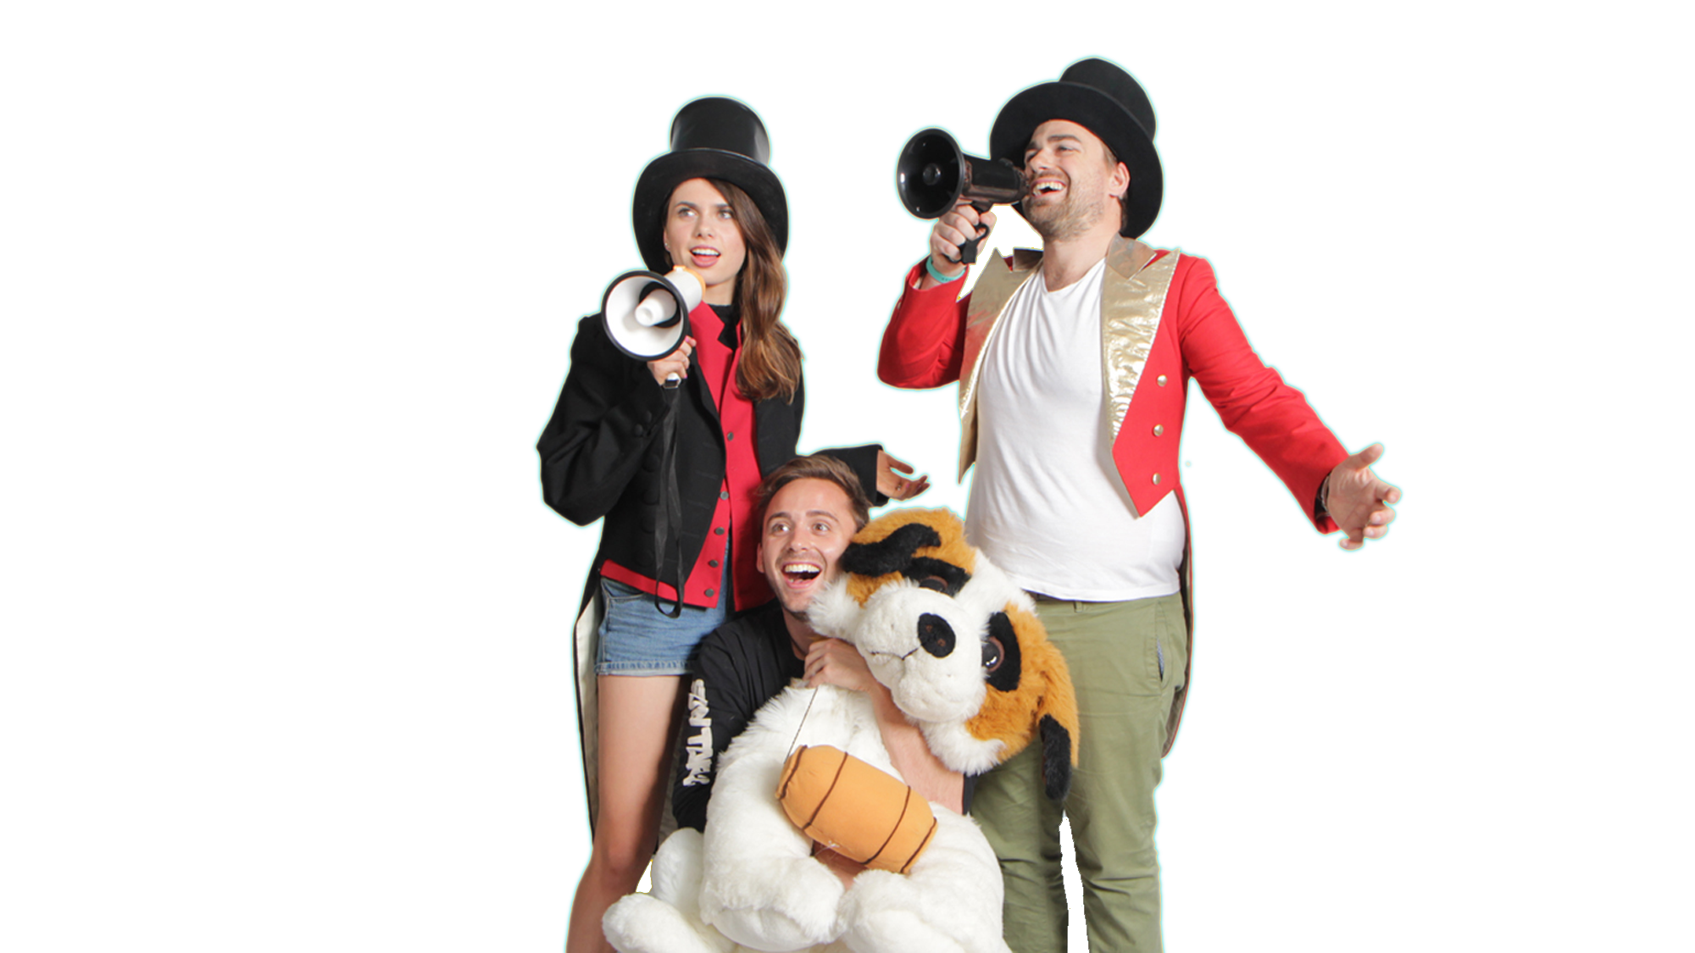
Did Carl really see a UFO? | 1
What is discrimination and is it always bad? | 7
Should you give up your teddy bear? | 12
Should we ban families? | 18
Do you want to become a vampire? | 23
Pets, pests and farm animals – why do we value them differently? | 26
Short & Curly is a fast-paced, fun-filled ethics podcast for kids and their parents or teachers, with questions and ideas to really get you thinking. It asks curly questions about animals, technology, school, pop culture and the future.
The activities in this pack are designed to be used alongside listening to the podcast, in the classroom, but can easily be adapted for use at home.

Slide 3
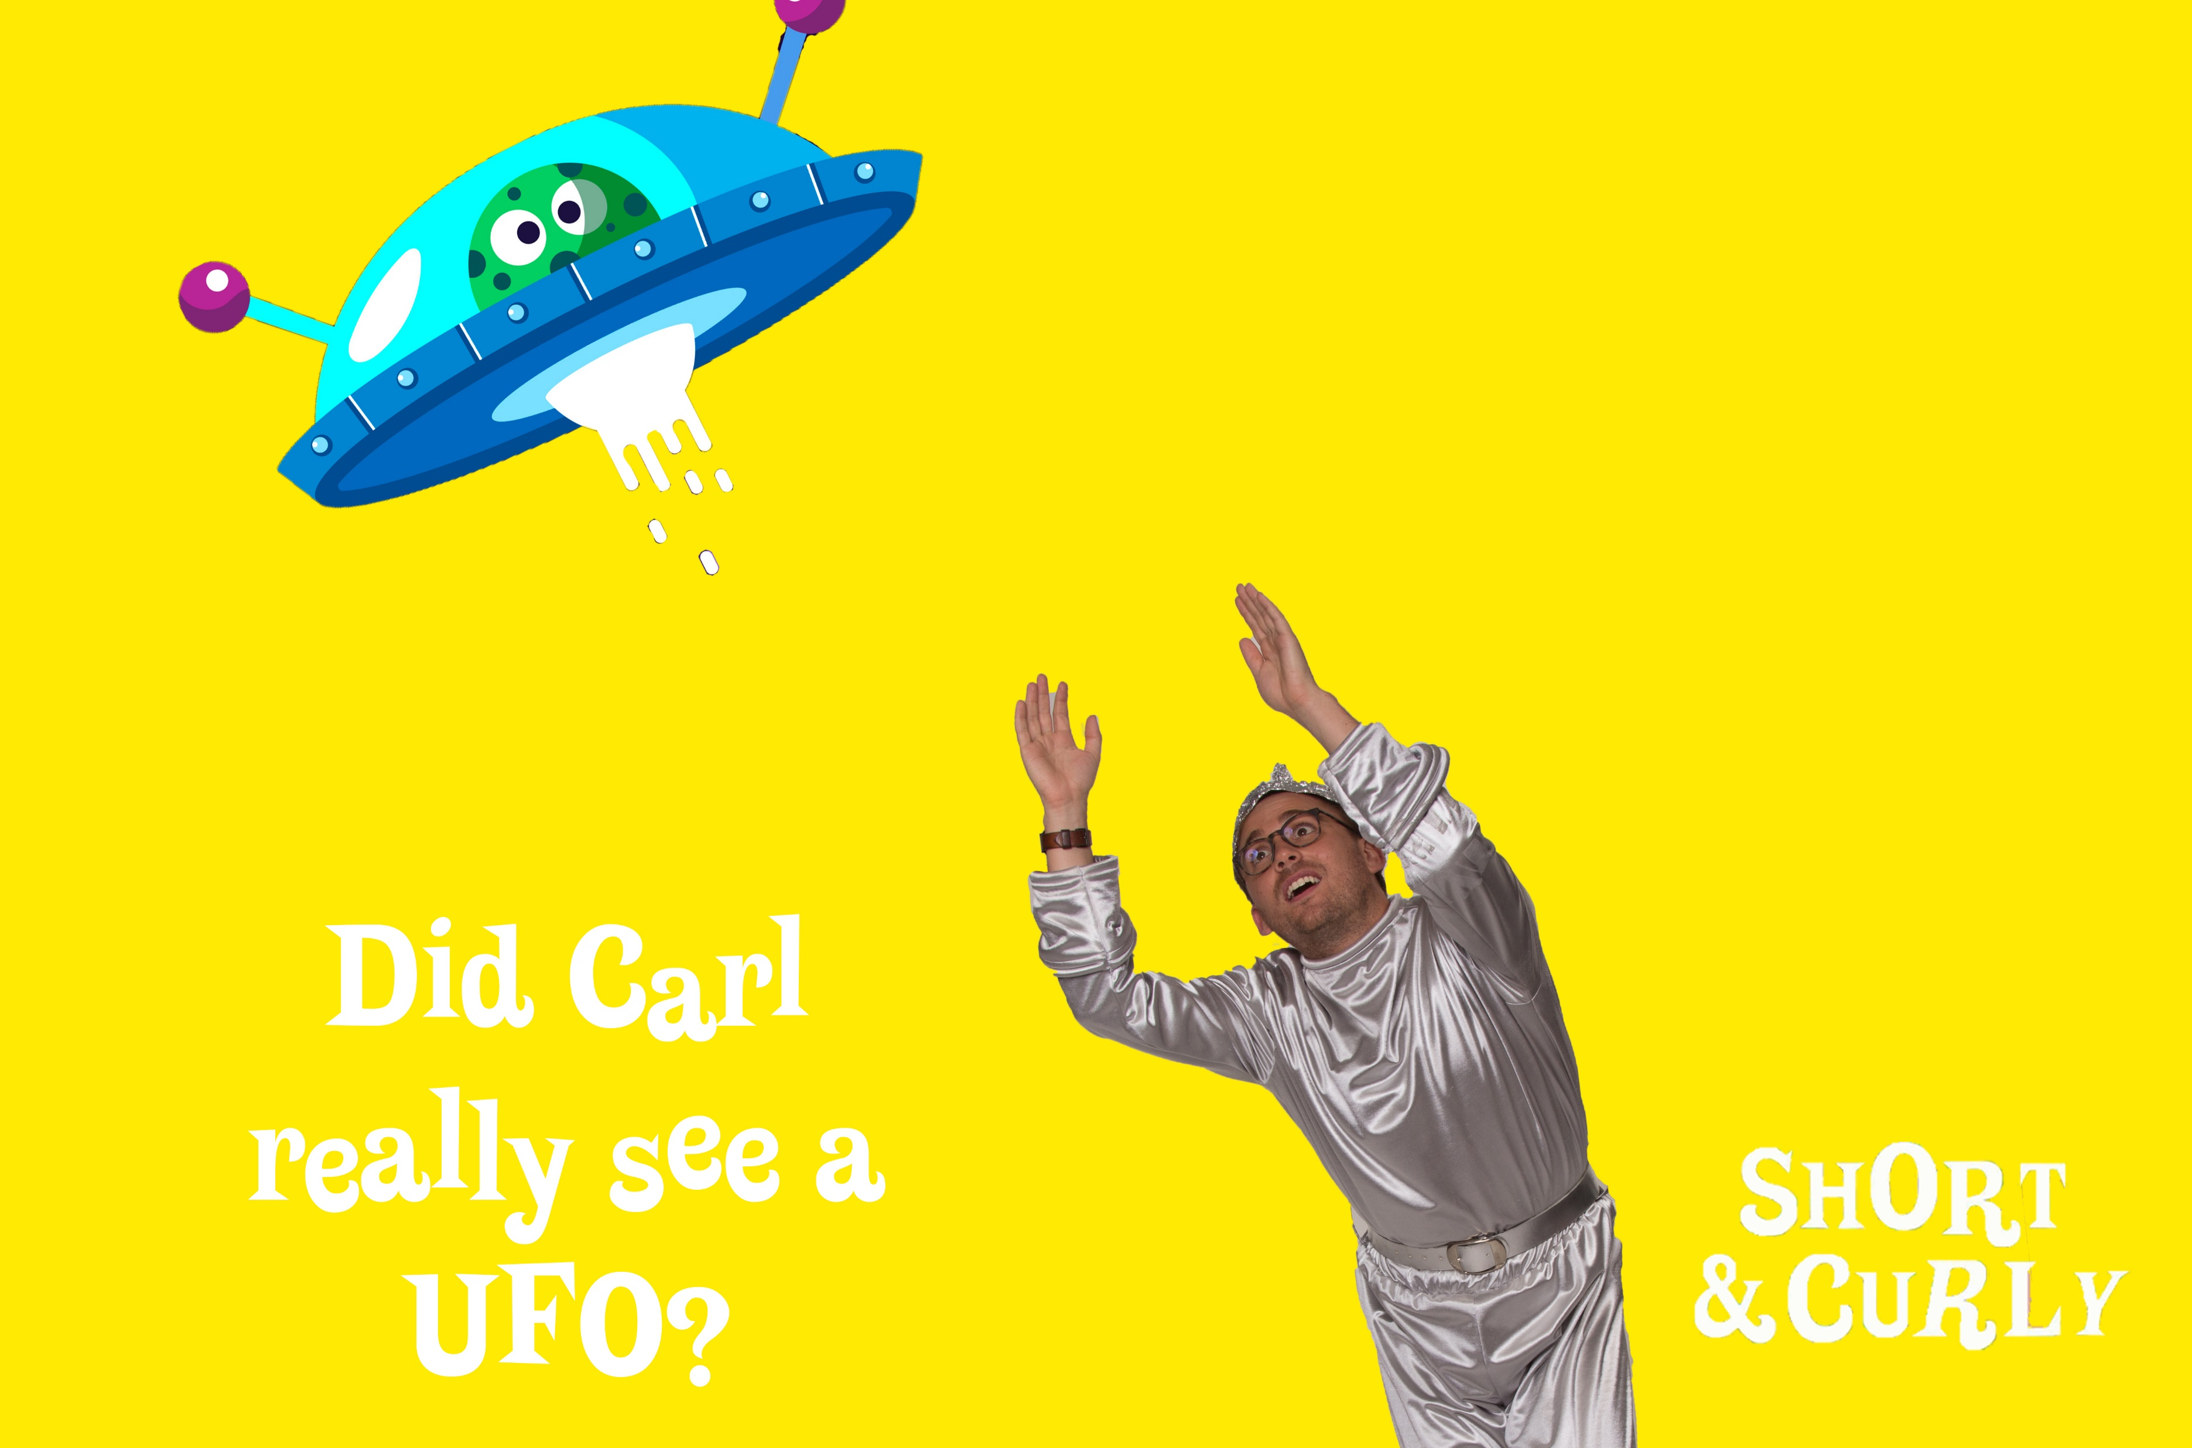

Slide 4
Episode 1: Is it ever okay to be a cannibal?
Did Carl really see a UFO?
Beliefs | Evidence | Reasoning | Justification
Begin with a brief discussion about the difference between ‘opinion’ and ‘knowledge’. Ask for examples of each and then compare them– what makes them different? (e.g. ‘Pluto is the best planet’ v. ‘Pluto is a dwarf planet’)
Next, ask students to think about what ‘beliefs’ are. How are they different to opinions / knowledge?
Ask students to each write down 2 or 3 beliefs, prompting if necessary, e.g. ‘I believe men and women are equal’, ‘I believe climate change is real’, ‘I believe the sky is blue’.
Next, students put a star next to the belief they are most confident about and discuss with a partner. This should bring up claims about reasons, evidence, and proof (perhaps not in those terms).
Bring the class back to a general discussion and ask for a few volunteers to offer their beliefs for discussion.
Ask: how do you know these beliefs are true? As reasons are given, write them down and then explain that most of their reasons will fit in to the following categories: memory, testimony, experience and logic.
(NB ‘logic’ is standing in for ‘priori’ justification. This is a tricky concept, broadly meaning knowledge gained or justified by reason alone, without the direct or indirect influence of experience. Logic is a workable stand-in for this activity).
Ask the students which of these kinds of evidence they think is the most trustworthy / reliable and why.
Discuss the strengths / weaknesses of each kind of evidence. Expand / explain the limitations of each as you move through them, using the notes in appendix 1 – as much or as little as is appropriate for your students.

Slide 5
Did Carl really see a UFO?
Next, write down and display three ‘false’ beliefs, e.g.
‘I believe pigs can fly’
‘I believe in time travel’
‘I believe [teacher name] is a robot’
For each statement, ask students how they know the claim isn’t true. This should connect with the different kinds of evidence mentioned earlier. Ask the students if they know that these aren’t true, or if just have an opinion that they aren’t true (they should understand that they know these are untrue due to logic).
Finally, ask students to return to their starred belief and discuss with their neighbour why they know it to be true, as opposed to just having an opinion that it’s true. After a few minutes, ask for volunteers to share their reasoning.
Because we experience the world entirely through our own senses, we can find it difficult to accept that our perceptions may be inaccurate or distorted. We tend to trust our own experiences and senses, even when they are not real. In fact, psychologists have found that people will even believe their own bizarre hallucinations rather than accept that they’re wrong!
It can be hard to change our beliefs if they are tied up with how we see ourselves as individuals. Indeed, beliefs are associated with a part of the brain integrally involved in self-representation—the ventromedial prefrontal cortex. We want to feel that our behaviour aligns with our beliefs, and so we rationalize our own actions and beliefs to try to preserve a consistent self-image. It’s uncomfortable to admit that we are fundamentally wrong
If you have any extra time ask the students to come up with the belief that they are most sure of. Put contenders on the board and have the class vote.
End with a discussion about why that belief earns so much confidence

Slide 6
Episode 1: Is it ever okay to be a cannibal?
Did Carl really see a UFO?
Part 2: Hunting out bias
To begin, briefly discuss the broad definitions of the following terms
Perspective: to understand something through your own senses and logic. Your point of view. (‘The sun is shining in my eyes and making it hard to see’)
Facts: unbiased and certain information about reality. (‘The sun is shining’)
Opinions: judgments, beliefs, and views about reality. (‘I love the sunshine’)
Bias: the presentation of an issue from a single point of view. (‘The sunshine has ruined my day’)
When we are being biased, we are not presenting information in a factual way without taking sides but are making an argument based on our own opinions and perspectives. Someone who does not like dogs might say that ‘all dogs are vicious’, making a statement based on their own view rather than on facts. (If students are struggling with sorting these from one another, simplify the process by creating a ‘facts v. opinions’ chart with a column for each. Work together to come up with examples).
Next, students will research a variety of real-world media and discern whether what they find is factual, or influenced by perspective, bias or opinion.
(You may wish to focus on one particular aspect, providing students with set articles to analyse, or you may wish to let them discover their own).
Ask students to find one or two articles of a decent length. Students may wish to specifically search for bias, or conversely to seek out reliable news sources instead.
Once students have an article for use, ask them to fill out the analysis template for discerning if news if biased or not (appendix 2)
Consolidation
Discuss: Why does bias exist, and why is it bad?
It is important to discuss this question with students so that they may understand why bias exists. There are many reasons why bias may be present in media: profit motive, political ideology, personal gain etc. For a more detailed explanation of the types of bias in media, check out https://fair.org/take-action-now/media-activism-kit/how-to-detect-bias-in-news-media/

Slide 8
Episode 1: Is it ever okay to be a cannibal?
Stereotyping | Prejudice | Discrimination
Part 1
Begin with a brief discussion about what each of these terms mean and how they are connected. It might help to offer a real-life example of each:
Stereotype: All blonde-haired people are vain and dishonest.
Prejudice: A blonde-haired person has never stolen from me, but I assume that all blondes will steal.
Discrimination: When you see a blonde-haired person, you cross the street or hide your purse. You avoid being friends with blonde-haired people. You would not employ a blonde-haired person.
Clarify for students that discrimination can mean different things, as discussed in the episode. There are both negative and positive types:
Negative discrimination is broadly defined as distinguishing differences between things or treating someone as inferior based on their race, sex, national origin, age or other characteristics.
Discrimination like this is often based on a characteristic or issue that is not relevant to the issue at hand. For example, if I were to say that a blonde-haired person was not allowed in my house because they like different music to me, I am using this as my reason for not allowing them in my home, even though musical taste has no impact on visiting my home.
Negative discrimination is the one we hear the most about, and we will look at this more closely later in the session. Now look at positive discrimination for a moment.
What is discrimination and is it always bad?
5

Slide 9
What is discrimination and is it always bad?
Positive discrimination is recognition and understanding of the difference between one thing
and another.
Explain that even when discrimination is based on gender, age, ability or race it is not
always illegal or negative.
Ask: can anyone think of an example?
Prompt: When have you been discriminated against for being a child?
- On rides at amusement parks.
- At pubs, only allowed in certain areas.
- Movies / TV ratings.
This is positive discrimination. The term refers to special measures which are taken in order create equality, or to ensure the health, safety or wellbeing of people. Discuss real-life examples, e.g:
Installing a wheelchair ramp at a school ensures disabled students have the same ease of access as able-bodied students.
Offering women’s only gyms and swimming pools allows women to exercise whose religion forbids them from doing so in front of men.
Explain that sometimes positive discrimination is used as a way of addressing certain systemic or entrenched discrimination or inequalities in a society. E.g., offering girls more places in tertiary STEM courses, or offering Indigenous scholarships for high schools and universities – due the underrepresentation of these groups at each.
Ask students to work with a partner to come up with a list of positive discrimination they would like to see and share responses as a group.
Systemic discrimination refers to patterns of behaviour, policies or practices that are part of the structures of an organization, and which create or perpetuate disadvantage for racialized persons. It has a broad impact on an industry, profession, company, or geographic area. E.g.: not hiring qualified women in male-dominated fields, paying certain people less than others for doing the same job, not hiring people from certain cultural backgrounds
6

Slide 10
Episode 1: Is it ever okay to be a cannibal?
What is discrimination and is it always bad?
Part 2: Negative Discrimination
In this part of the session students will examine how we respond to difference by looking at what happens in a group when one aspect of our identities is used to discriminate.
Warm-up. Ask students to think about the idea of the ‘in-crowd’ for a moment.
Ask: what is the in-crowd?
The in-crowd is generally a group that is privileged in some way or has social power
Why do people want to be a part of it?
Feeling of belonging, being part of the ‘superior’ or dominant group
How do people on the outside of it feel about being excluded?
How do you feel about yourself and others when you are not a member of the ‘in crowd’?
Think / pair / share these answers and briefly discuss.
A Class Divided
Provide students with some background to the documentary they will be viewing, on the so-called Blue Eyes / Brown Eyes experiment of 1968 – named ‘A Class Divided’ (15 min clip https://www.youtube.com/watch?v=yHpWzZh2xA4) – appendix 3
Display the viewing guide (appendix 4) for notetaking while watching.
7

Slide 11
Episode 1: Is it ever okay to be a cannibal?
Once you have finished viewing the video, split students into groups and give them one ‘big question’ each to tackle, or if working with individual students assign them with a question or two each. You may need to help them to structure discussion, research online or talk it through with you as they do so.
Some are multi-faceted and will need scaling down – it is up to you which ones you use.
Who in the film determined which differences matter? Who do you think decides in real life?
How was the message about which differences matter reinforced in the film? How is this message reinforced in real life?
Why, for the most part, do you think the students went along with Elliott’s experiment?
What is the lesson Jane Elliott wished her students to learn?
What does Elliott’s classroom experiment suggest about what can happen when one aspect of our identities is valued over others?
Eye colour is not related to power in our society. What are some characteristics that are?
Who determines which differences matter? Why do individuals and groups either go along or not go along with these decisions?
How do beliefs about differences in our society shape the way we see ourselves and others? How do they shape the way others see us?
Consolidation
Students respond with a short written piece to answer an open-ended question. Encourage them to express themselves freely, and to honestly reflect on the video.
What lesson did you learn from the film?
What is discrimination and is it always bad?
8

Slide 13
Episode 1: Is it ever okay to be a cannibal?
Should you give up your teddy bear?
Transitional Objects | Personal Growth | Resilience
Begin with a brief discussion about teddy bears and other comfort objects. Ask:
Why do children get attached to teddy bears and other toys?
If in a classroom setting, students may wish to offer examples of their own similar objects, such as security blankets. If in a home setting, it may be possible to have such objects on hand to kick the session off. Ask:
How does / did this object make you feel? Why were/are you so attached to it?
Introduce students to the term transitional objects, or comfort objects, offering a brief definition.
A comfort object, transitional object, or security blanket is an item used to provide psychological comfort, especially in unusual or unique situations, or at bedtime for children. Among toddlers, comfort objects may take the form of a blanket, stuffed animal, or a favourite toy, and may be referred to by nicknames.
For older students, you may delve further into this psychological concept and explore how transitional objects act as a tool in separation from the mother:
Comfort objects are representative of a crucial step in children developing a sense of self, and of personal development. Through the use of these objects which ‘scaffold’ the separation, children learn their own coping and resilience skills, step by step, like training wheels.
Not all children have one special comfort object, many children have a variety of them – teddy bears, blankets, thumb sucking – or some may have none at all, though they still move through these developmental stages in the same way
10

Slide 14
Episode 1: Is it ever okay to be a cannibal?
Should you give up your teddy bear?
Explain that you will be exploring the idea of resilience and personal growth / development.
Part 1: emotions
It is important to ground this topic in the understanding that emotional responses vary in depth and intensity depending on individuals and specific situations. From here, students will explore positive coping strategies and stress management.
Explain that in this activity you are going to think about strong emotions. Ask:
What are some ‘strong emotions’?
Share examples and record some responses on the board.
Strong emotions are those emotions we feel deeply. They can be positive emotions like excitement and happiness or negative emotions like fear or jealousy. They might start out weak, but then build up to be stronger and stronger over time, or they might become strong very quickly. Strong emotions can be harder to manage. We need to use our strengths and our skills to help us manage how we express our strong emotions.
Introduce the idea of scaling by drawing and displaying any sort of scale (a thermometer, blank number line etc) and explain that this will be our ‘emotional thermometer’
Ask students to think of the type of experience that might make them a little bit angry, or mildly upset, with a low score on the thermometer. Model this process by coming up with something relatively minor, such as ‘forgetting my homework’ or ‘bad traffic’.
Move through the levels of intensity, being careful to point out that you are looking at intensity, not the type of emotion. A high score could refer to intense anger or rage, or it could refer to feeling very excited or joyful.
11

Slide 15
Episode 1: Is it ever okay to be a cannibal?
Should you give up your teddy bear?
Arrange for students to work in pairs to draw their own emotions thermometer, writing each emotion next to the appropriate zone on their thermometer.
Next, ask students to add a triggering event or series of events that they think may lead to the person feeling this emotion:
Once complete, invite pairs of students to report back to the class, and to talk about the sorts of situations that can lead to people feeling an emotion at a weaker or stronger level. Try to draw out that similar events / experiences can have very different effects on different people.
Point out that people are different. This means that while one person may have a strong reaction to a certain experience, someone else may have a milder reaction.
Part 2: Resilience
Ask: What is resilience? Brainstorm as a group.
Resilience is emotional strength. It’s the ability to cope when things go wrong. Resilience helps you to bounce back and adapt to stress and change in a healthy way following difficult situations or challenges.
Firstly, tell students they will begin by evaluating their own resilience-building skills. The aim of this is not to score points, but to identify which areas students can focus on to build their resilience. (This will need to be handled sensitively and should be carefully nuanced so as not to bring up trauma for specific students. A relatively benign example should be modelled first– something like a friend moving away or not getting a job you wanted)
Students complete the resilience reflection exercise (appendix 5), drawing on challenges they have faced in the past.
Reflect on responses as a group, discussing as students are comfortable to do so. This should be scaffolded by you depending on how forthcoming students are – you can share on your own experience to encourage responses.
12

Slide 16
Episode 1: Is it ever okay to be a cannibal?
Should you give up your teddy bear?
Resilience-building skills
So, how do we build our resilience? Explain to students that they can work through three simple steps in building their own resilience and devising strategies for solving problems.
Reframe Your Thoughts
Resilient people are able to look at negative situations realistically, but in a way that doesn't centre on blame / fault or brooding over what cannot be changed. Instead of viewing adversity as insurmountable, focus on looking for small ways that you can tackle the problem and make changes that will help. Focusing on the positive things you can do can help get you out of a negative mindset.
You can use this approach to better cope with challenges. Think about challenges in more positive, hopeful ways. This way, instead of getting stuck in a loop of negative emotions, you can learn to see these events as opportunities to grown and develop new skills.
Seek Support
Having people you can trust and confide in is important for building resilience. Talking about the difficulties you are coping with doesn't make them go away, but sharing with a friend or loved one can make you feel like you have someone in your corner. Discussing things with other people can also help you gain insight or even new ideas that might help you better manage the challenges you're dealing with.
Focus on What You Can Control
When faced with a crisis or problem, it can be easy to get overwhelmed by the things that feel far beyond your control. Instead of wishing there was some way you could go back in time or change things, try focusing only on the things that are in your control. Even when the situation seems dire, taking realistic steps to help improve the situation, however small these steps may be, can improve your sense of control and resilience.
13

Slide 17
Episode 1: Is it ever okay to be a cannibal?
Should you give up your teddy bear?
Problem-solving strategies
Ask students to work in groups of four to brainstorm some problems or decisions that children around their age have to deal with from time to time.
Each group then chooses their ‘best’ problem for another group to work on and reads it out. Students / groups are each assigned a problem to work on from here.
Alternatively, you can assign them problems from the following scenarios list:
One of your friends lies to you about something important
Your best friend forgets your birthday
A friend is really mean to someone
You hear something nasty someone else has said about you
Your friends are being mean to you
Your pet dies
You are feeling stressed and overwhelmed by schoolwork
You are having trouble sleeping
You are worried about something and can’t stop thinking about it
Give students time to work through their assigned problems, then present their solutions to the class and explain their thinking.
Why was this the best strategy?
Were there any strategies they decided not to use? Why?
Write and display all problem-solving strategies as they are discussed, creating a problem-solving board.
14

Slide 18
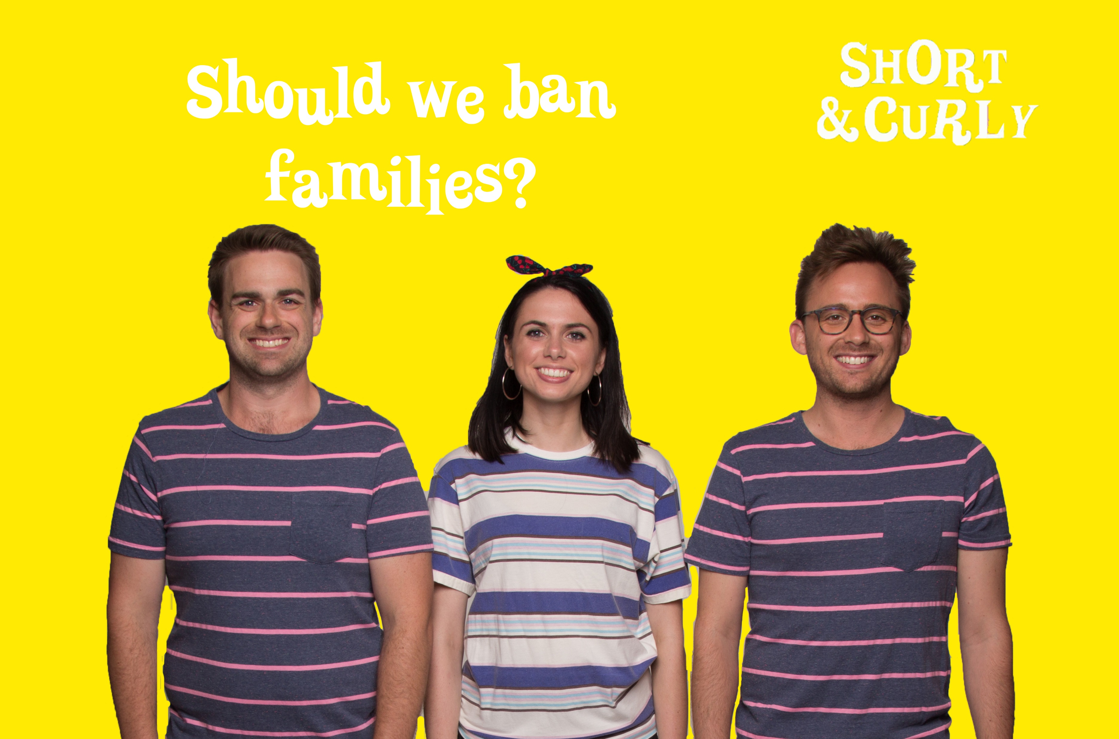

Slide 19
Episode 1: Is it ever okay to be a cannibal?
Should we ban families?
Plato | The Nuclear Family | Diversity
In this session, students will examine Plato’s philosophical assertion that families should be abolished, and explore the limitations of the ‘nuclear’ family. They will look at different types of families and define what makes a ‘family’.
Begin by asking students for their thoughts on this episode, and Plato’s suggestions about families.
What do you think of this idea?
Can you imagine your life if the family unit was abolished? How might that look?
Next, ask students if they’ve heard the term ‘nuclear family’ and if so, what they think it means.
Explain that the nuclear family is a term that was coined in the mid-20th C and refers to a family unit made up of two married adults of opposite genders and their dependent child/ren who all live under the same roof. At the time the term was first used, the nuclear family unit was seen as being vital to the stability of a society as a whole, and was promoted by certain groups of people as the ideal. Ask:
What are your initial thoughts on the nuclear family as a definition of stability?
What are its limitations?
Do you agree that this type of family is central to a stable society? Why / why not?
Explain that in this session students will be examining the concept of the nuclear family and analysing its place in today’s society by looking at a range of families and family types.
16

Slide 20
Episode 1: Is it ever okay to be a cannibal?
Should we ban families?
Family is defined as a specific group of people that may be made up of partners, children, parents, foster parents, aunts, uncles, cousins and grandparents. The definition of biological family is a group of people who share common ancestors. However, a family can be made up of anyone a person considers to be their family. A family shares emotional bonds, common values, goals and responsibilities.
Begin with a group discussion, asking:
What makes a family?
What is unique about my family?
How is my family similar or different to a nuclear one?
Once it has been established that there are many different types of families in
our society, ask:
What are the benefits of having different types of families in a society?
Why is it important to learn about different types of families?
Next, students will define the word ‘family’. Give students post-it notes on which to write a sentence, using the sentence starter ‘A family is…’
Make sure responses can be displayed in one visible place. Students take a few minutes to complete their sentences and then contribute their sentences to the ‘family board’.
The idea is to illustrate that families are many different things and have different meanings for different people. Ask:
How is your family similar or different to the nuclear one?
If there are no non-nuclear families in the group, simply ask students to think about other families they know / know of that are different. How exactly are they different? (single parent, divorced parents, same-sex parents, adoptive siblings, foster families etc)
.
17

Slide 21
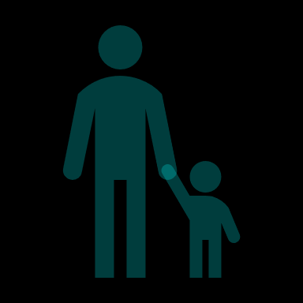
Should we ban families?
There are many categories of families in today’s society:
Nuclear family: Two parents of opposite genders and their children
Same sex family: Two parents of the same gender and their children
Single parent family: One parent and their children
Blended family: A family where one or both parents have children from a previous relationship
Foster family: Foster parents and their foster children. Foster parents may or may not be relatives of the child, but they are acting as parents to that child while he or she is living with them
Family of choice: Two or more people choosing to treat one another as a family, emotionally and/or legally
Explain to students that everybody's family is different. No two families are exactly alike. Give an example, e.g. If you were to look at my family picture, it would be different to yours because I have no brothers or sisters and you have three )
Next, ask students to think about what makes their family unique. This will lead into a discussion about family traditions. Ask:
What are some things about your family that makes it different to everybody else’s?
You can model responses to this question, e.g. Every Christmas we play a game of cricket in the backyard and the losing team have to jump in the pool with their clothes on.
Explain that this is a ‘tradition’ unique to your family. Have students jot down their own family traditions and briefly discuss.
Next, ask students to draw three different family types that they know of. E.g., their neighbours might have two kids and one parent
The aim here is to get them thinking about different ways of making up a family and displaying them altogether. Use the family categories and definitions to add to these.
18

Slide 22
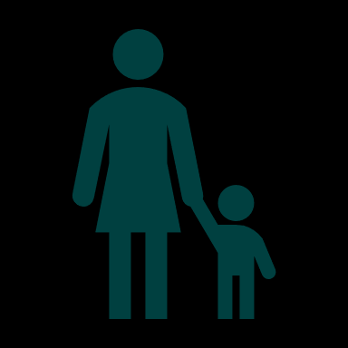
Should we ban families?
Extension option 1
Introduce students to the term ‘meritocracy’, and give an informal definition:
Meritocracy emphasises that an individual can overcome obstacles and adversity to succeed in life.
In a meritocracy, all people have the same opportunity to pursue the ‘Aussie dream’.
Ask:
Do you agree that we live in a meritocracy?
Does everyone in Australia have the same opportunity to succeed?
Are we all equal in being able to pursue our dreams?
Next, give students the following article to read (https://aeon.co/essays/pluck-and-hard-work-or-luck-of-birth-two-stories-one-man), or read excerpts to the class as time permits. After reading, discuss the article and revisit the questions you asked at the beginning.
Extension option 2
Make a family tree or write a family history. Students may need to interview their parents or other family members in order to complete this. Most students will be familiar with family trees.
Encourage students to make their family trees a little different. Perhaps they can write one interesting thing about each person on their tree or illustrate each person as they create it.
19

Slide 24
Episode 1: Is it ever okay to be a cannibal?
Do you want to become a vampire?
Eternity | Mortality | Immortality
Begin this session with a broad opening question: If you had the choice, would you choose to live forever? Gauge initial responses before explaining that you are going to look more closely at this idea, as explored in the episode.
Ask students to draw two columns, headed ‘Pros’ and ‘Cons’. Explain these terms if need be.
Students need to fill out as many for each column as they can think of, in ten minutes. They can work in any grouping for this.
Once students have filled out their worksheets, share responses and record. Ask:
Which side do you sit on?
Have students reflect honestly about which they would do if given the choice.
You may wish to structure a debate on this topic, and assign students to ‘for’ and ‘against’ the statement ‘immortality is a gift’
21

Slide 25
Episode 1: Is it ever okay to be a cannibal?
Do you want to become a vampire?
Next, explain to students that they will be looking at how they might live their lives differently if they were immortal. Ask them to think about their day today, starting when they woke up this morning.
If you were immortal, what might you have done differently today?
Work through the day in this way, examining each activity and how it might have been different.
Students then write a letter to a friend updating them on their life, as if they were immortal. The letter should illustrate how things are different for the, and how life has changed.
Once these are written, share them with the group.
Next, split students into two groups. The first group designs an advertisement for ‘everlasting life’, as a new – very exclusive - product being marketed. This can be a recorded radio ad, video, poster or written brochure. Their job is to pretend they are the company behind a new product which grants eternal life to its customers, at a very high premium. They need to be able to sell the idea to consumers convincingly.
The second group will be the ‘activists’, designing an awareness campaign to stop the spread of the product. They will need to explain why it is harmful and should be stopped. Students may need to view some activism websites / ads to get some ideas on how to structure and design this.
Consolidation
Revisit the question ‘If you had the choice, would you choose to live forever?’
Have your views changed at all? Why / why not?
22

Slide 27
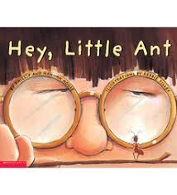
Pets, Pests and Farm Animals
Equal Consideration | Moral Welfare | Sentience
Part 1
Begin the session by viewing the online book ‘Hey, Little Ant’ by Phillip and Hannah Hoose
(click image to access video).
Explain that you will be reading a book about a boy and an ant in which the boy tries to
decide if he should squish the ant, and the ant makes a compelling case for his survival.
The ending asks the reader to decide on the outcome.
After watching, ask students to recall the reasons the boy and the ant each had for
their perspective.
Discuss and record these. As you do so, ask:
Is this a good reason? Why / why not?
After going through the reasons and thinking about their validity, ask students to think about whether they think it is right or wrong to squish the ant. Be very clear that there is no right or wrong answer to this question.
Ask students to choose a side – ‘squish’ or ‘save’, and to think of several reasons to support their argument.
Give students a few minutes to discuss / jot down their reasons and then discuss as a group.
Some guiding questions:
Is it right or wrong for the boy to squish the ant? What is your reason?
Have you ever squished an ant? Why did you do this? Was this the right thing to do?
Is it always wrong to kill bugs? Why or why not?
.
24

Slide 28
Pests, Pets and Farm Animals
Next, instead of simply choosing a side students will explore both perspectives, the boy’s and the ant’s, by writing a diary entry from each perspective.
Ask students to write one paragraph for the boy and one for the ant, beginning with ‘Dear Diary’ and outlining the day’s events. Here it is important to think about how each might be feeling, and to take into account how and why their views on the day might be different.
Students share diary entries and discuss.
Part 2
Ask students to write 2-3 examples for each of the following categories of animals: Pets, Food, Pests
Once students have examples, share them as a group and discuss. Ask:
How do we treat each category of animal differently?
Pets are looked after, cared for and even doted on by owners
Farm animals are essentially products, used for profit by farmers and food companies
Pests are eradicated, as they cause damage or harm (and sometimes cost)
Ask:
What makes a dog a pet and not food or a pest?
Why is a rat considered vermin and yet guinea pigs are pets?
How does it make you feel to think about eating a cat?
Next, ask students to discuss why we have different ideas about how we should treat each type of animal. The point to draw out is that the distinction is largely cultural rather than biological, i.e. we take on certain ideas about how we treat different types of animals according to the culture we grow up in.
.
25

Slide 29
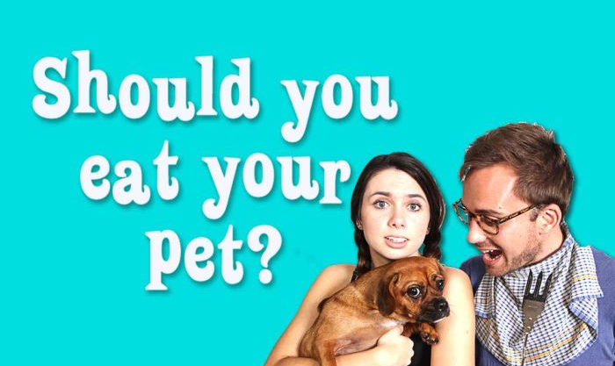
Pests, Pets and Farm Animals
Provide some examples to illustrate this, e.g. in some cultures dogs are considered dirty, much like rats are in our culture. On the other hand, in India it is a great taboo to kill or harm cows – even for food - which are seen as sacred beings.
Ask: can you think or any animals that fit into more than one category? (Rabbits, pigs). Next, ask: how is the rabbit / pig treated differently in each case?
Give students time to discuss this and then share responses as a group.
Consolidation
At the end of the session, ask:
Should we feel guilty about killing insects?
Give students access to the following New York Times article for discussion
https://learning.blogs.nytimes.com/2014/11/19/should-you-feel-guilty-about-killing-spiders-ants-or-other-bugs/
After reading, students can answers to the following questions. Answers may be written or discussed.
Should you feel guilty about killing spiders, ants or other bugs? Why?
Does this change if it is a big that can sting you or harm you?
Does it matter if the bug is indoors or outside? Do the circumstances matter? Is it ever not okay to kill a bug? Why?
Does it matter to you how cute a bug is — like a green caterpillar? Do you consider other factors, like whether you think it’s a helpful bug or a harmful one?
.
Click here to listen to this episode, where we look at the ideas we have about which animals are ok to eat, and which are not
26

Slide 30
Appendix 1
Memory
Memory is notoriously unreliable. It changes over time and can often be influenced by things such as personal experience and bias: we tend to recall things as we would like to have experienced them, or as it suits a particular outcome. Memory is a subjective form of evidence, which makes it inherently fallible.
Reconstructive memory: This means that through the process of retrieving memories we tend to fill in any gaps in those memories using other influences, including logic, prior experience and personal goals. This happens without us being aware it is happening, meaning that we experience these memories as real and objective even when they are not.
Testimony
Testimony, particularly eyewitness testimony, is more reliable than memory but still fallible. The justice system – juries, lawyers, police officers and so on – tend to value eyewitness testimony highly, and it is generally seen as a reliable source of information. However, more research in this area has revealed that eyewitness testimony can be significantly influenced by a range of psychological factors, including:
Anxiety, stress and fear
Reconstructive memory (see above)
Line of questioning.
Leading questions refer to questions which are phrased in such a way as to prompt a specific answer. E.g., asking someone ‘did you see the man cross the road?’ implies that there was definitely a man crossing the road, and is more likely to prompt a ‘yes’ than asking ‘did you see anyone cross the road?’
27

Slide 31
Bias Analysis Sheet
Title:
Author:
Publication:
List some facts and any opinions you find:
Could you tell what the author’s perspective about the topic or issue was? How?
Do you think this article was biased? Why or why not?
Bias Analysis Sheet
Title:
Author:
Publication:
List some facts and any opinions you find:
Could you tell what the author’s perspective about the topic or issue was? How?
Do you think this article was biased? Why or why not?
Facts | Opinions
Facts | Opinions
27

Slide 32
Notes on A Class Divided
Following the assassination of Dr. Martin Luther King Jr. in 1968 Jane Elliott, a primary school teacher in a predominantly white town in the state of Iowa, designed a two-day classroom experiment help her year 3 students understand discrimination.
She did this by using eye colour to divide the class, and privileging students with one eye colour over the other; the blue-eyed students on the first day and the brown-eyed students on the second. In doing this, she was trying to show her students how society can influence our beliefs about our own identities and the identities of our neighbours.
Members of the privileged group were told they were smarter, quicker, better behaved, and more respectful than their peers in the other group, and they received benefits such as longer break-time, access to the playground equipment, and second helpings at lunch. They were also instructed not to interact with classmates in the other group, who had to wear coloured collars to help distinguish them.
In a short period of time, Elliott found that her once peaceful classroom became one in which many privileged students asserted their dominance through bullying and teasing. Students in the less privileged group shrunk into themselves and became disengaged, while others became angry and physically violent.
28

Slide 33
Viewing guide: A Class Divided
What reasons does Mrs Elliot give to support her claims that one group is superior over the other?
What strategies does she use to convince each group that they are superior / inferior?
What privileges does she give the superior group, and which are taken away from the inferior group?
What questions or comments do you have about the video?
29

Slide 34
RATING RESILIENCE
How do you rate yourself for:
Getting support from people in your life in times of stress?
Managing your emotions when dealing with stress/problems
Solving problems in a way that is helpful/beneficial
What people in your life do you get support from, if any?
What strategies do you use to solve problems?
How do you manage stress / intense emotions?
RATING RESILIENCE
How do you rate yourself for:
Getting support from people in your life in times of stress?
Managing your emotions when dealing with stress/problems
Solving problems in a way that is helpful/beneficial
What people in your life do you get support from, if any?
What strategies do you use to solve problems?
How do you manage stress / intense emotions?
1 | 2 | 3 | 4 | 5 | 6 | 7 | 8 | 9 | 10
1 | 2 | 3 | 4 | 5 | 6 | 7 | 8 | 9 | 10
Never
Sometimes
Often
Never
Sometimes
Often
1 | 2 | 3 | 4 | 5 | 6 | 7 | 8 | 9 | 10
1 | 2 | 3 | 4 | 5 | 6 | 7 | 8 | 9 | 10
Never
Sometimes
Often
Never
Sometimes
Often
1 | 2 | 3 | 4 | 5 | 6 | 7 | 8 | 9 | 10
1 | 2 | 3 | 4 | 5 | 6 | 7 | 8 | 9 | 10
Never
Sometimes
Often
Never
Sometimes
Often
299

