Slide 1
Schools Pack

Slide 2
When does curiosity become rudeness? | 1
Should children swear? | 2
Should we ban homework? | 5
Should you be punished for something you did a long time ago? | 6
The backyard chicken dilemma | 8
How to win an argument with your parents | 10
Do you have to forgive someone who says sorry? | 12
Should you give money to homeless people? | 15
Do athletes have to be role models too? | 16
Short & Curly is a fast-paced, fun-filled ethics podcast for kids and their parents or teachers, with questions and ideas to really get you thinking. It asks curly questions about animals, technology, school, pop culture and the future.
The activities in this pack are designed to be used alongside listening to the podcast, in the classroom, but can easily be adapted for use at home.

Slide 4
When does curiosity become rudeness?
Begin with a class discussion about disability and why someone in a wheelchair might be stared at. Ask students to share about a time when they were walking down the street and saw someone they felt very curious about, for any reason.
As they passed by, you were probably tempted to turn your head. We have all felt this temptation at some point, and sometimes perhaps we sneak a glance – but usually we attempt to try to refrain from outright staring. So what, exactly, is bad about turning your head or looking for too long at a person you are curious about?
To warm up, students will have a staring competition in pairs. Make sure they are sitting with someone they don’t know particularly well (this activity will emphasise the directness of staring) and make sure they stand to do the staring contest; this way, it is less about purely eye contact.
Rather than seeing who can go the longest without blinking, this competition will be to see who can stare openly at another classmate without breaking eye contact for the longest time.
Afterward, ask students: how did you feel during the staring contest?
This is an important discussion for the lesson. Draw out specifics about how students felt to both stare and be stared at, eg uncomfortable, giggly, embarrassed.
Next, explain that staring is a form of body language and can become problematic because it may be interpreted in different ways, and can make people feel self-conscious.
Ask: what does self-conscious mean? Describe the feeling of being self-conscious.
Why is it unpleasant?
Use this to start a discussion about the feeling of being ‘othered’ by unwelcome staring, and how this in turn can make us feel as though we are separate to or on the outside of the group or community.
Next, ask students to think about a time we might stare at something or someone. Discuss responses. Here, draw out the fact that sometimes we stare because we are just curious about something, or seeing something a bit different to what we’re used to.
Even though it might be quite innocent to stare at something or someone out of curiosity, how and why might this create problems for someone like Lucas?

Slide 5
Next, ask students to think about times when staring might be ok. What situations make it acceptable to stare?
Make a list of these scenarios as a group, discussing what makes each one ok.
For comparison, also create a list of situations in which it is definitely not ok to stare.
What differentiates these two categories?
Next, ask students to form groups to think about why humans tend to want to stare at those who look different to most.
What is the reason / purpose of staring? Many studies have been done on this topic, but first let’s have a go at figuring this out for ourselves.
Discuss as a group, before explaining that the human brain is wired to enjoy categories. We are constantly categorising the things we see, unconsciously (safe / dangerous, adult / child, dark hair / light hair etc). Even when we only glance at someone’s face, we are subconsciously taking in a LOT of information and categorising that person.
Because of this categorising – which we’ve been doing since we were born – we are primed to look for any differences to our main categories, and when we see them we find it harder to quickly assign them to a category. Hence, we might stare!
End the activity with briefly revisiting the question (is it rude to stare?) to come up with a one sentence response that encompasses all the ideas you have explored as a group.
As a final activity, choose volunteers to act out the following scenarios, silently, and have the group guess the specific meaning of each, based solely on body language and facial expression:
A teenager begs her parents to borrow the car
A man sees something interesting on his phone
Someone wants to start a fight with someone else
A small child is nervous
A wife is extremely angry and not speaking with her husband

Slide 7
Should children swear?
Begin by explaining that in this activity students will NOT be saying or hearing any swear words in the classroom, but looking at what makes a bad word ‘bad’ and why swearing – especially for children – is considered taboo.
Begin by asking, what does ‘taboo’ mean? Discuss any responses as a group, then clarify with a formal or informal definition – prohibited or restricted by social custom.
Begin by asking students to think about the term ‘social custom’:
What does this mean, and what are some we observe in our society?
What are some social customs that might have been around in the past, but aren’t anymore?
Why do we have them in the first place?
In pairs, ask students to have a quick chat about WHY they think we use swear words, as individuals and as a society.
Think about when you’ve heard a parent swear. What was the situation? Thinking about that situation, what purpose did the swear word serve?
Discuss responses as a group, drawing out that swear words are most commonly used as intensifiers (to emphasise ideas) and expletives (to replace words like ‘ouch’ and ‘no way!’)
As we have heard, most kids admit that they swear behind their parents’ backs. So, why do you secretly swear, or why do you think others do? Why is it something you want to be able to do? Have a think about why you enjoy saying things that are a bit naughty.
Social research shows that using ‘taboo’ words in conversation often suggests that the speaker wishes to relate to the person they are addressing more closely. For young people, swearing is often seen as a more grown up way of speaking.

Slide 8
Ask:
What are the rules about bad language in your home?
Is swearing allowed at all? Why / why not, and by whom?
What words or language are strictly forbidden in your home, if any?
Next, ask students to work through the following statements and decide whether or not these define swear words:
Words that bad and used when angry
Words that insult other people
Words your parents would not like to hear you say
Some words you hear in movies / TV / games
Words that are racist, sexist or obscene
Words that help to express intense emotion or feeling
Words that add humour to a funny story
Students work in pairs to identify six different scenarios in which they think it is quite normal for people to swear and decide if it’s acceptable or not.
Next, ask students – still in pairs – to answer and discuss the following three questions:
What type of words make you uncomfortable?
What are some words or things we can do or say instead of swearing?
Do your parents have any words they use instead of swearing, or when they almost swear?
As a final activity, come up with a list of new class taboo / ‘swear’ words: nonsense words students may use to express frustration, anger, shock or as intensifiers.

Slide 9
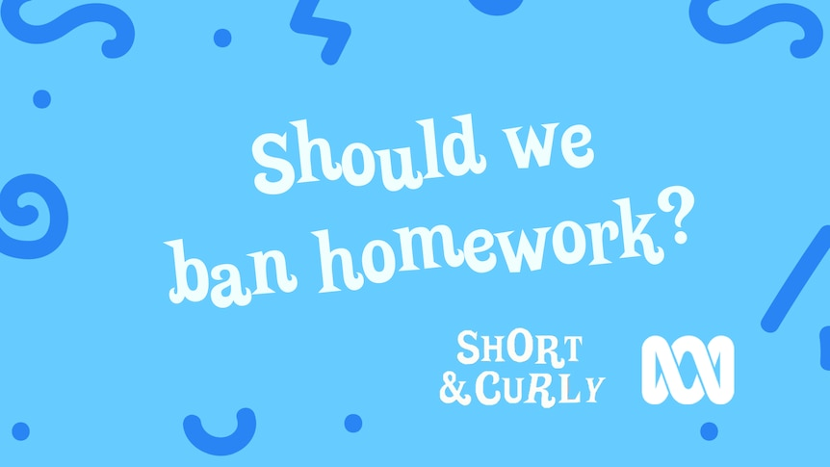

Slide 10
Should we ban homework?
This activity will culminate in students designing their own homework grid, so these activities should be run with this in mind.
So, is homework a necessary evil or something we can do without? And, if we must do it, how much is too much?
A recent study found that students who were regularly assigned homework scored higher on standardised tests. But when kids reported having more than 90 to 100 minutes of homework per day, their grades went down.
Spend some time discussing this as a group. In particular, the pros / cons and how spending too much time on homework can actually have a detrimental effect on academic results.
Why? Discuss. Eg burn out, stress and anxiety, fatigue but also kids spending less time outside, with family, having down time etc.
Next, ask students: what about the fairness of homework? Can you think of any reason why setting homework for every student may be inequitable (that is, unfair)?
Explain that students are about to imagine they are a teacher and must assign homework to one of the following three students
Student 1 is Tamara. She is absolutely obsessed with touch footy and sport. She has two dogs and loves taking them for runs when she has time, but is often looking after her younger siblings because her mum does shift work and isn’t home in the afternoons. Tamara struggles with English and finds homework challenging because she usually doesn’t have her mum around to ask for help.
Student 2 is Arjun. Arjun is an only child who loves coding and playing violin. He enjoys being in a quiet space working on coding problems or algorithms, with no disruptions. Arjun likes to go for walks and ride his bike but isn’t very sporty. He prefers solo activities that involve a lot of thinking. Arjun’s family speak Hindi at home, not English, and they live in a very small flat so he doesn’t have much room to do schoolwork.
Student 3 is Mila. Mila is all about art and being creative. She loves beading, weaving, painting, drawing and singing her heart out. Mila enjoys being with groups of people having fun but also enjoys quiet times on her own, creating something beautiful. Mila is a carer for her mum, who has a chronic illness, so her afternoons are usually spent with her.
Imagine you are a teacher to these students. How would you design three different types of homework for these students?
Alternatively, students may wish to design a homework grid that is suitable for all three, or at least caters to their tastes. The idea is to make tasks that are easily integrated into home life, cater to a range of learning styles and interests and that are enjoyable to complete.
Lastly, you are going to design your dream homework for a term. Your teacher will give you the bits you HAVE to include (this might link to the units you are learning this term), and the rest is up to you to design according to your home and your life. The easiest way to do this is to use a homework grid of 20 activities. Each week, you choose two of these to complete.
Think outside the box! If you have a big backyard, do some activities outside (eg a botanical drawing, a treasure hunt with map and coordinates). If you spend a lot of time at extra-curricular activities you can incorporate your homework into car time or activities to do at the supermarket when shopping.

Slide 11
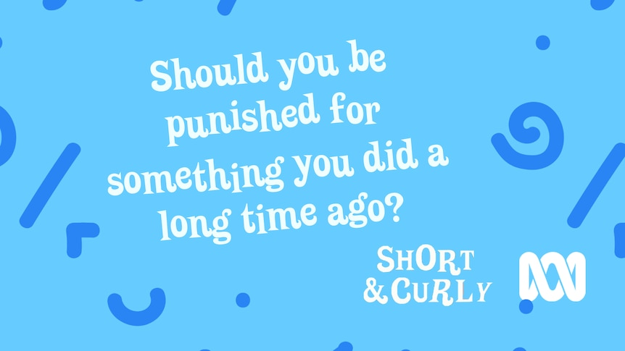

Slide 12
Should you be punished for something you did a long time ago?
As a warm-up, ask: Have you ever been punished for something? What was it, and what was your punishment?
Discuss student responses.
So what is the point of punishment, and do you think it works?
Have students work in pairs or groups to brainstorm responses to this, guiding them as necessary to concepts such as:
Deterrence
‘Paying’ for something you’ve done
Eliciting remorse
Ask students to, off the top of their heads, say whether or not old ‘crimes’ should be punished or dismissed (also called ‘forgiving’). Given the amount of variables inherent in the question, this should generate a discussion and comments like ‘it depends’.
Hands up if you have ever held a grudge against someone for something they have done in the past.
If comfortable, ask students to share about what the perceived harm was, and why it cannot be forgiven.
Next, ask: what are some offences that someone can do to or against you that you think it would be easy to forgive and move on from? Eg pushing a friend over, yelling / swearing at someone etc
Write down examples of these minor wrongs.
Next, ask: what about things that you think are unforgiveable? Is there anything your best mate could do that you would never, ever forgive?
Now, thinking about these things – do you think this act should be punished or consequences given? How?
Are there any wrongs that should be punished regardless of how much later it is? What are they?
Once students have decided on what harms should always be punished, split then into groups and ask them to brainstorm appropriate punishments for each one.
Come back together as a group and discuss responses.

Slide 13
Part 2 / Extension
Ask: what if you stole something from a shop when you were two. Should you be punished now? Why / why not? Theft is still a crime, after all.
When does a crime become ‘historical’, or long enough ago that we count it as being in ‘the past’ and therefore not a current criminal issue? Who gets to decide this?
Next, explain to students that a new law has recently been passed in NSW that changed the sentencing of historical crimes. Before now, crimes from the past were sentenced based on practices that were current at the time the crime was committed. The new bill means that these crimes will now be punished according to current sentencing practices.
Ask students if they think this new law is more or less fair? Why?
Next, explain that students will be role playing as young criminals from the past, sentenced according to laws of the time and real crimes, often committed by children and adolescents but punished as harshly as adults. Split students into groups of 5 or 6 and assign each one a role from the following characters and their crimes:
Stealing fish from a pond or river
Counterfeiting the copper coin
Impersonating an Egyptian
Assault with intent to rob
Give students a crime which they must enact for the class, coming up with a scenario leading up to the crime.
Once each group has performed and explained their crime, the class may ask them questions before deciding their sentence. Students will then devise a way to judge and sentence each criminal based on their crime and its seriousness. Explain that the sentencing should fit the crime, and ultimately encourage remorse and / or deterrence from doing it again.
Once each group has shared their punishments, read out the actual sentencing each of these crimes got at the time they were committed.
Stealing fish from a pond or river. Punishment: public flogging
Counterfeiting the copper coin: 7 years’ transportation
Impersonating a Egyptian: Hanging
Assault with intent to rob: death / 7-14 years’ transportation
Extension: 21 crimes
As an extension activity, students can research and record the so-called ’21 crimes’: the list of offences that saw roughly 160,000 people transported to Australian penal colonies.

Slide 15
The backyard chicken dilemma
Start with a brief discussion about the Short and Curly episode and ask students for their ideas, thoughts, feelings about this moral dilemma.
Then, ask: so what is a moral dilemma? Or just a dilemma in general?
Have you had one yourself? If so, what was it?
So when faced with a dilemma or a difficult decision, how should we make that decision?
Explain to students that dilemmas often involve more than one ‘right’ decision
Discuss, prompting with questions:
What things should be considered when we are faced with hard decisions?
How do you make hard decisions?
In order to solve ethical or moral dilemmas, we generally try and do what is right. But, knowing what is right is not always easy! So how do we decide what is right (or what is wrong) The thing with ethical (or moral, really for these purposes both terms can be used) dilemmas is they can involve more than one right way to approach a problem, each with different positives and negatives (thus working out which values might be more important to you when assessing). Ethical dilemmas often involve making decisions which are neither all right not all wrong, that’s why they are tricky. It’s hard to work out what to do.
Next, students will write a list of their personal values.
To get to your list of values, begin by answering the following questions:
What are some values you and your family live by? Eg kindness, compassion
What about values you / your friends hold as really important?

Slide 16
Display or hand out the list of personal values (appendix 1), and ask students to highlight their top ten value.
Once you have your list of personal values, find a partner to work with to solve some dilemmas. It can be tricky when you have to decide with another person. That is the challenge! You and your partner must work through the dilemmas to decide what you would do, and how you justify this based on your values.
Dilemma 1
There are three people in a hot air balloon: a man, and old woman and a young child. The balloon is about to crash and one person must be ejected from it to save the others. Oh, and the old woman has the cure for cancer and the man knows how to operate the balloon safely.
Who do you choose, and why?
Dilemma 2
You live in a country where health care is not free. Your child has a rare medical condition and needs very expensive surgery to save their life – a million bucks! Someone offers you a suitcase containing a million dollars in cash, should you choose to take it. But, if you do, someone you don’t know will die.
What do you do?
Dilemma 3
Your friend tells you that they committed a crime. They explain that they are having trouble sleeping at night and feel you are the only one they can trust with their confession. A few days later, you read in the paper that someone has been arrested for your friend’s crime.
Do you:
Go to the police and tell them what you know
Try and persuade your friend to tell the police themselves, and threaten to do it yourself if they don’t?
Say nothing, do nothing – you won’t betray your friend.
After each dilemma, discuss as a group or have students write their responses in a paragraph, justifying their decision and outlining the process.
If there is time, have students pair up with someone who made a different decision to them to debate and argue their cases.

Slide 17
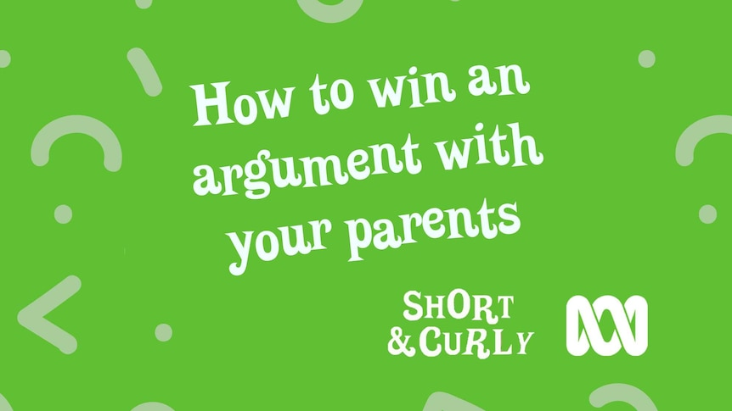

Slide 18
How to win an argument with your parents
Introduce the activity by explaining to students that the real skill in winning arguments is reasoning!
Today, students will be learning a process called C-E-R:
Claim – what you know
Evidence – How you know it
Reasoning – Your thinking
This is the process that scientists work through in order to prove a theory as fact. Their goal is to make a claim that can be supported by enough evidence and to convince others of their claim.
Tell students that today they will be engaging in debates about well-known nursery rhymes, using this process to formulate convincing arguments.
Work through the C-E-R process as a group first, using an example such as ‘why I should be allowed to stay up later than 9pm’
First, begin with your claim. A good claim is clear, concise and doesn’t use vague terms. Eg ‘As I am now in Grade 6, it is only fair that I should have a later bedtime.’
Next, evidence. These should be real, concrete examples that support your claim. Eg ‘last weekend I stayed up until 10pm and still did all my jobs the next day, and finished all my homework. And, the average bedtime for a child aged 10-11 is between 9:30 and 10pm.’
Reasoning brings it all together and connects the evidence to the claim: ‘based on this evidence, it would be both unreasonable and unusual for me to not be allowed to stay up until 10pm’.
Students will use the process to undertake the next activity.
Nursery Rhyme arguments
Next, put students in pairs or small groups and explain that they will be examining well-known fairy tales to construct arguments about their central characters. They may need to re-read these stories in order to gather evidence and construct their arguments.

Slide 19
How to win an argument with your parents
Give students the following scenarios to work through, arguing their side of the story.
Scenario 1
The wolf from Little Red Riding Hood says he was forced into eating her by Red Riding Hood’s grandma, who was actually the mastermind behind the whole operation. You are his lawyer, arguing his case. Put together the outline for your closing argument for the misunderstood Big Bad Wolf.
Scenario 2
Two of Snow White’s Seven Dwarves have filed complaints against Snow White, saying she bullied and harassed them for years. They want compensation. You are to argue their case on their behalf at a tribunal.
Scenario 3
Cinderella’s step sisters are suing Cinderella for slander. They say she has brought their names into disrepute by spreading a skewed version of events leading up to the ball. You can choose to be either Cinderella’s representative, arguing against the sisters, or you can represent the sisters themselves in suing Cinderella’s estate.
For each one, students must put together a C-E-R response and argue their case. This may be run as a competition, or simply as a group activity.
Have students present / argue their cases after each scenario.

Slide 20
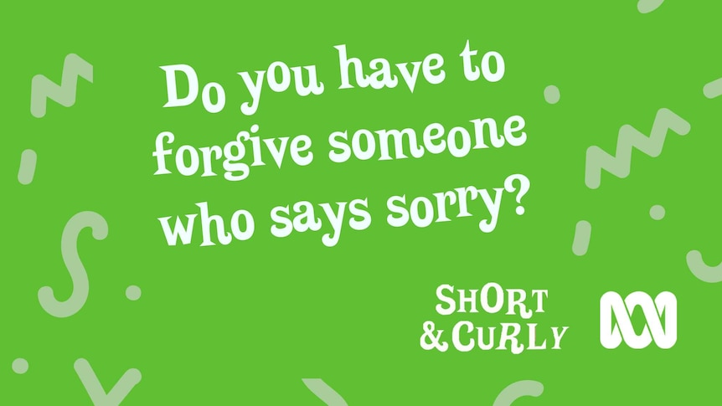

Slide 21
Do you have to forgive someone who says sorry?
Begin this activity with a discussion about wrongs and forgiving.
Ask: Has a friend ever made you sad or upset? What happened?
Take 2–3 responses from those comfortable in sharing . Try to make connections between students' comments.
Ask: Has anyone forgiven a friend or someone who made you sad? What was that like?
Alternatively, you can also ask: have you ever been forgiven by someone? How did you know when you had been forgiven? Have you ever not been forgiven for something? How did it feel?
Next, ask: what is necessary for you in order to be able to forgive someone?
Draw out that often we need to see some sort of attempt at amends or apology to be able to forgive.
Next, explain that while we have explored the questions of whether or not we must forgive someone who apologises, today you will be investigating apologising. What is it, why do we need to do it, and is it always necessary?
So: when do we need to apologise? Not every single error we make will require an apology. Do we need to apologise for spilling our drink on the table? Probably not, unless it harms or inconveniences another person.
Next, consider those situations that do require an apology, remembering that not all of these situations will require the same sort of apology.
Let’s start by thinking about the least serious kind. This would be the short, informal and immediate apology we give someone if, for example, we bump into them. This sort of apology is appropriate when something has happened that is unintentional / accidental and a one-off (ie doesn’t happen all the time)
Ask students to give examples of what sort of situations would require this sort of apology.
Pick two students to role play this type of harm and apology.

Slide 22
Next, we have the mid-range apology. This requires more thought and attention and applies to a situation where we really bothered someone or upset them, hurt their feelings, or cost someone money, time or resources.
Consider situations where this sort of apology might be appropriate. Perhaps they themselves have had to do this. What were the circumstances?
Lastly, we have the major apology. This sort of apology applies when we have done something deliberately mean or harmful and our relationship with someone is damaged.
Next, explain that students will look at how we should apologise in each of these situations.
First, let’s take a look at what not to do. We’ve all heard an apology that didn’t feel real (often from our siblings!)
What sort of apology is one that doesn’t really man anything to the person?
Ask volunteers to demonstrate an inadequate apology. Afterwards, ask: what makes it inadequate?
Ask students now to act out a fake or empty apology for one another. After doing so, ask them to reflect on what made it ‘empty’? Was it the tone of voice? The word used? Body language? Have students discuss short, monotone, or forced apologies and their effect on the person harmed.
Explain to students that finally, they will be building a good apology and – most importantly – looking at how to make any necessary repairs.
Split students into groups and give each one of the following scenarios. They will then work on an appropriate apology.
Your sibling has way more pocket money saved up than you do, and you really need some to go to the movies with friends. You ‘borrow’ $20, thinking you’ll pay it back. But your sibling needed that money for the same day, and couldn’t go out.
You are mucking around in the classroom and accidentally bump into someone, who whacks their shin on a desk. Really hard. Because you don’t want to get into trouble, you run away.

Slide 23
You hear some people saying mean things about a friend of yours. You don’t join in, but you also don’t speak up. Your friend later hears that you were there and didn’t say anything, and is upset.
You’re playing footy and someone from the other team says something offensive to only you. It makes you really angry. Without thinking, you give them a big shove and they fall hard, hurting themselves.
First, review what happened and why. Was the harm accidental or intentional?
Next, focus on empathy. Even if we don’t immediately feel sorry, we can try and understand how others might feel, and that can help. An apology shouldn’t be made because we are told to, or because we don’t want to get into trouble.
Next we make the repairs. Most often, we think a well written letter or a heartfelt apology will cover it, but actually the real repairs come in the form of actions, not words. If we say sorry for something, and then never change our behaviour or make up for what we did, that sorry doesn’t mean much.
At this point, ask students to think about whether or not it is okay to explain why you did something when you’re apologising, or to defend your actions somewhat. Is this okay, or does this undo the apology? Discuss as a group.
So, for the final part of the activity have students brainstorm in their groups what words AND actions would show the other person you are sorry and working to repair what happened.
Consolidation: have students explain or role play their apologies and any repairs made, explaining their reasoning for each.

Slide 25
Should you give money to homeless people?
Ask: One you have given someone money, should you have any say in how it’s spent? And, should we give money to people even if we suspect they’re going to spend it in a way we don’t want them to?
Next, explain to students that they will be exploring the concept of ‘altruism’ and how it can benefit society. Ultimately, they will plan a project to benefit the homeless locally.
Begin in pairs or small groups, asking students to consider the different needs we all have.
Working together, students will come up with a list of these needs and place them into categories, such as ‘material / physical needs’ and ‘emotional needs’. Once students have brainstormed these, it may be useful to briefly review Maslow’s hierarchy of needs.
After reviewing, students discuss whether or not these needs are being met for different members of society, and which specific needs are probably not being met for people who are homeless.
Next, students can research homelessness in the local area. Do charitable organisations already exist to support them? What are they? What are the biggest issues facing this community?
Finally, students will work on an altruistic project to benefit the homeless. This may be as big or small as you wish, e.g. volunteering at a local charity or hosting a drive / fundraiser at school. Whatever the idea, it should be based on the needs identified through the activity and research undertaken.
Once they have an idea, groups can write a proposal for their idea outlining why it is a good one, and providing details on how it would work.
Begin this session by explaining to students that today they will be looking at the ethics of giving.
To start with, ask students to imagine the following scenario:
Great Aunty Mavis gives you $20 for your birthday to spend ‘on anything you like.’ The next day, you ask a parent to take you to the shops to spend your birthday money. You know what you want, and it’s your absolute favourite fast food and brand of lollies. You are pumped. On the way to the shops Your mum says Great Aunty Mavis has said the money is not under any circumstances to be spent on junk food. She thought something like a book, some drawing things or a soccer ball.
IS this fair or not?
In pairs, discuss this scenario and make a list of all the reasons why it IS fair, and all the reasons it isn’t.
Once done, discuss this as a group.
Next, ask students to discuss in pairs whether or not they think giving money directly to homeless people is a good idea or not?
This should draw out a number of ‘it depends’ type responses which can be discussed. Eg, it may depend on how much money you yourself have, what you think they need the money for etc.

Slide 26
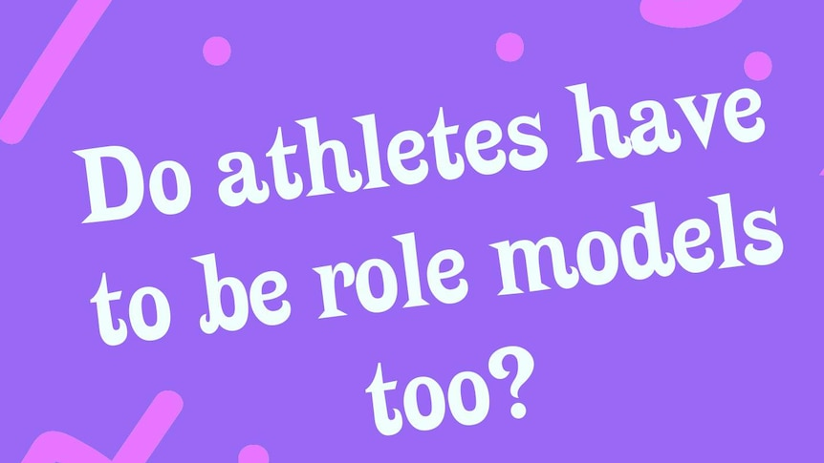

Slide 27
Do athletes have to be role models too?
For this activity, students will undertake one or several of the following role model activities to create a class experience around what makes an inspirational role model.
First, choose 5-6 inspirational people that you think your students will recognise, who may be seen by them as being appropriate role models. Display their names / images and ask students to work in pairs or small groups to identify them and suggest why they are considered role models.
Suggestions: Dylan Alcott, Ash Barty, Adam Goodes, Grace Tame, Greta Thunberg, Sam Kerr.
As students research, write key words or phrases to describe each one on the board, for example, ‘brave’, ‘cares about people’ or ‘determined’.
Encourage students to get to the characteristic rather than just talking about what the person has done. So rather than saying ‘Sam Kerr was named Australian of the year in 2018’, try ‘advocate for women in sport’.
Create and display a word cloud of these traits or characteristics. Ask students to discuss in their pairs/groups if there are similarities between the different role models. What are they?
Next, ask students to choose one person who they find inspirational. Get them to write a short paragraph about why they are inspired by this person. They can use sentence starters such as ‘I look up to X because…’ or ‘I am inspired by X because…’
Now ask students to take it in turns to read their paragraph to their partner (or to the whole class if you have time), without revealing the name of the person. Can the class guess who they are talking about?
End with asking students how they would react if their inspirational person did something they thought was wrong.
You may suggest specific things such as cheating at their sport, getting into a public fight, or doing something wrong that is not connected to their field of excellence, ie in the personal life.
Would this make you reconsider this person as a role model? Why / why not?
What things would make you not admire this person anymore?

Slide 28
Personal values list
Compassion
Kindness
Loyalty
Discipline
Freedom
Courage
Perseverance
Speaking up for others
Equality
Honesty
Hard work
Justice
Responsibility
Dignity
Diversity
Friendships
Family
Gratitude
Community
Individuality
Forgiveness
Charity
Self belief
Reliability
Humility
Creativity
Duty
Respect
Fairness
Curiosity
Adventure
Tradition
Empathy
Generosity
Independence
Giving back

